Slide 1

Data Preparation for China Regional Model
China Energy and Climate Project
February 13, 2012

Slide 2
Outline
Background & Objectives
Data Overview
Four Phases of Balancing
Potential Policy Analysis
Challenges

Slide 3
Background & Objectives
As the largest emitter, China is important in addressing global change.
China’s energy and emission intensity reduction target is disaggregated into provinces. Some pilots programs are also implemented in particular regions in China.
To balance the regional development is a great task for China as well.
To date, no regional model with newly released regional data is built. Most regional input-output research using data which takes 2002 as the base year.
We plan to develop a new China regional model using most recent data (2007). This model can be applied in multiple energy policy analysis.

Slide 4
Data Overview
China regional IO tables (ChinaIO.xls)
30 provinces of mainland China
42 sectors,
including 5 energy sectors (coal, crude oil & gas, refined oil, coking & nuclear fuels, fuel gas, and electricity & heat),
and 24 sectors in secondary industry
Household and government consumption
Incremental inventory and fixed capital investment
Domestic inflow and outflow
Import and export
China national and regional energy balance tables (1.xls, 0503.xls)
30 provinces of mainland China
11 sectors, 20 energy products
Consumption, incremental inventory, domestic inflow and outflow, import and export at provincial level
Detailed energy consumption data for 39 sector in secondary industry at national level

Slide 5
Data Overview
China Statistics Yearbook (2007)
Macroeconomics data
China Finance Yearbook (2007)
More details in government behavior
China Fixed Capital Investment Yearbook (2007)
More details in investment
China Industry Yearbook (2007)
More details in industry, especially for State-owned enterprises (SOEs)
Unfortunately, they are inconsistent with each other…

Slide 6
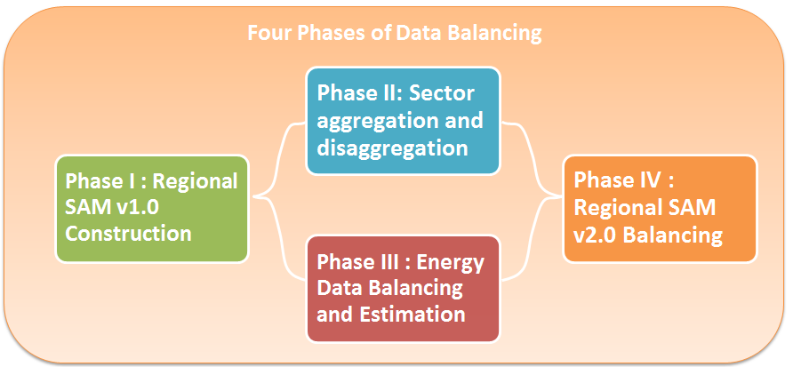
Four Phases of Balancing
First glance at regional IO tables (ChinaIO.xls)
Clean and perfectly balanced…
However, in fact they have…
Lots of negative values…
Intermediate input, depreciation and capital input
Lots of implicit imbalances…
Government income and expense
Total inflow and outflow of a certain industry of all the provinces
Very big error terms in some provinces…
Even much larger than the total output for some sectors (Gansu crude oil & gas)
We have to balance them stage by stage

Slide 7
Four Phases of Balancing Phase I : Regional SAM v1.0 Construction
Balancing manually with the principle:
least negative values with least change
no additional quantitative assumptions
30 SAM v1.0 with 42 sectors (no incorporation with energy data… allsam.gdx)
G1: central government which only do transfers and savings
Regional trade surplus or deficit goes to household
 | A | C | F | H | G1 | G2 | T | DX | X | I
A | ca | ac |  |  |  |  | sa
C |  |  |  | ch |  | g2d |  | der | er | cs
F | fa
H |  |  | hf |  |  | hg2 |  | dhr | hr
G1 |  |  |  |  |  | g1g2 |  |  |  | cg1s
G2 |  |  |  |  | g2g1
T | ta |  |  |  |  |  | tr
DX |  | drc |  | drh
X |  | rc |  | rh
I |  |  | dp | psv | g1sv

Slide 8
Four Phases of Balancing Phase II : Sector aggregation and disaggregation
Aggregation of sectors in line with energy data
42 sectors to 29 sectors, including 5 energy sectors
Disaggregation of crude oil & natural gas sector
To split the crude oil and gas with information from energy data
29 sectors to 30 sectors, including 6 energy sectors

Slide 9
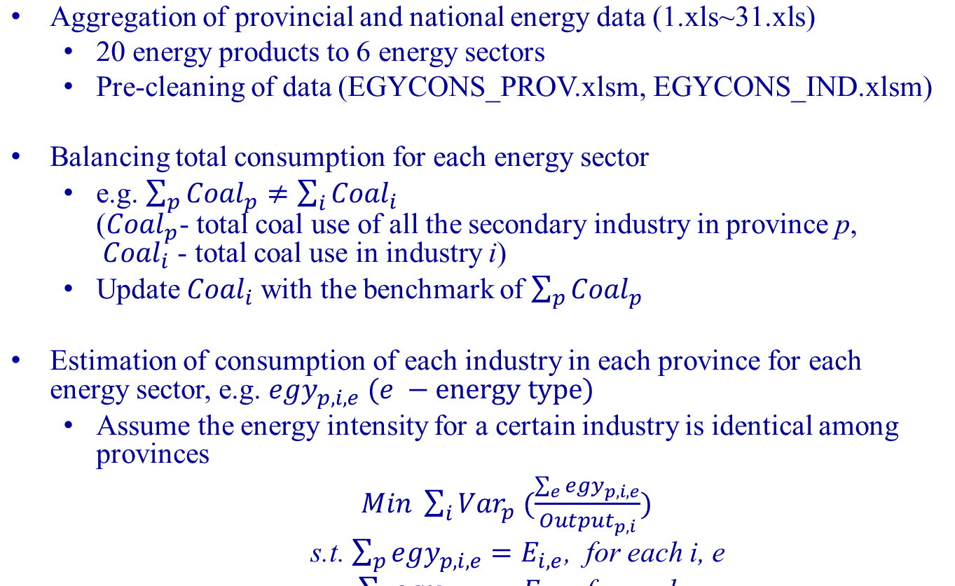
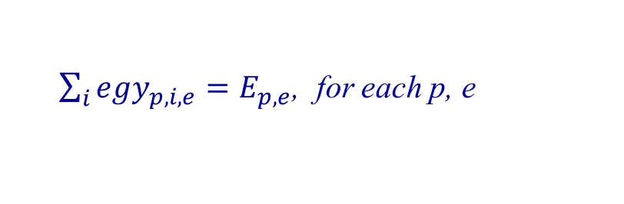
Four Phases of Balancing Phase III : Energy Data Balancing and Estimation

Slide 10
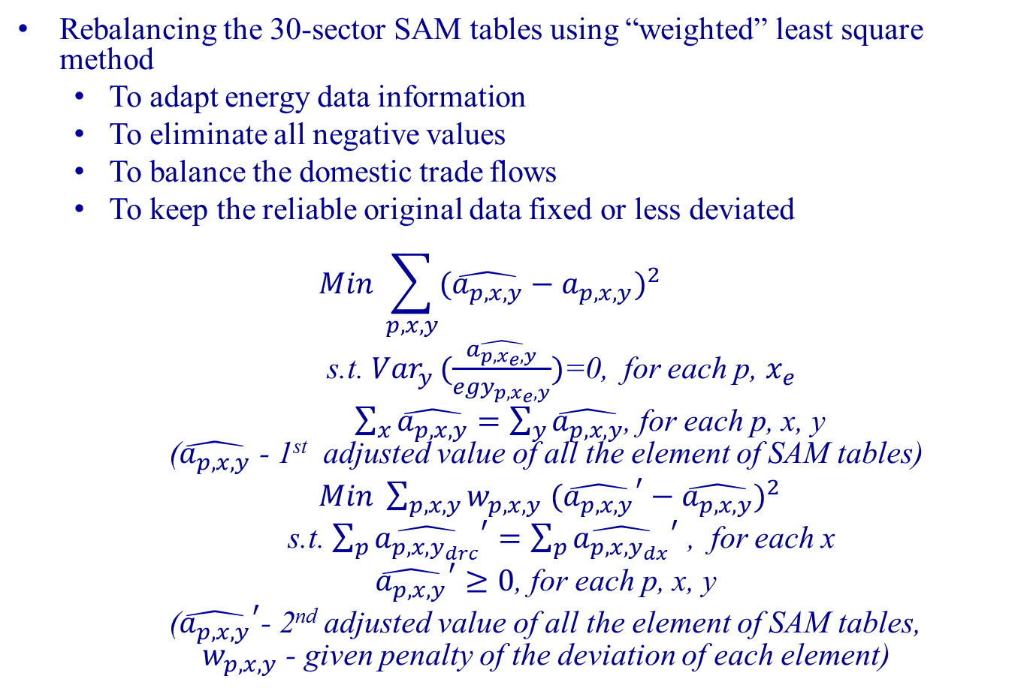
Four Phases of Balancing Phase IV : Regional SAM v2.0 Balancing

Slide 11
Potential Policy Analysis
Emission trading:
Emission intensity targets of all the provinces achieved w/o trading mechanism

Slide 12
Challenge
China changed a lot after 2007…
Fuel reserves data, household data
Government (and SOEs) behavior

